Slide 1

Adult Classification Dataset
MLCC-Bangkit Project 2020
Member:
Shelvia Andi
Asriyanti Ali
Jeremy Christian Wisandjojo

Slide 2
01
Project Design
METADATA
FRAMING
&
HYPOTHESIS
02
03
DATA PREPARATION
04
TECHNIQUES
RESULTS
&
CONCLUSIONS
05

Slide 3
Metadata Description
Columns | Type | Description
Age | Numeric | Age of person
Workclass | Categorical | Class of individual
Fnlwgt(Final Weight) | Numeric | Sampling weight
Education | Categorical | Education degree
Education_Num | Numeric | Encoded of education degree
Martial_Status | Categorical | Marriage Status
Occupation | Categorical | Individual Job
Relationship | Categorical | Residence Status
Race | Categorical | Race
Sex | Categorical | Gender
Capital_Gain | Numeric | Gain generated from investment sources other than salary
Capital_Loss | Numeric | Loss incurred from investment sources other than salary
Hours_per_week | Numeric | Working hours
Country | Categorical | Country of Origin
Target(Income) | Categorical | Income range

Slide 4
Framing and Hypothesis
The Problem is framed as:
A binary classification which predict whether a credit applicant annual income will be in one of two classes ( >= $50K and < $50K)
In details:
What Machine Learning model do? Predicting a credit applicant annual income class
Our ideal outcome? To suggest people worth giving loan to
Success Metrics?
- Success Metrics: How much money generated from credit interest
- Key Results: 10% improvement in preventing default payment compared to heuristics
- ML Model is deemed a failure if: predicted annual income is no better than heuristics.
ML Model Output? 2 classes of annual income range, >= $50K or <$50K
How to use model output? To be used as part of credit worthiness evaluation

Slide 5
Data Pre-processing
Data Pre-processing | Description | Checklist
a.Data Quality Assessment : 1. Data Types 2. Missing Values 3. Duplicate Values | 1.Assess each data type is at correct format. E.g, age is numeric, workclass is categorical, etc. 2.No missing values found on numerical data, ‘?’ is imputed with ‘Unidentified’ on categorical data 3.‘EducationNum’ column is found to be label encoded version of ‘Education’ column, thus ‘Education’ is dropped.
b. Categorical Features Encoding | Apart from education, the rests of categorical features are nominal. Mixed of encoding methods is performed depends on feature’s cardinality. One hot encoding for low cardinality and frequency encoding for high cardinality.
c. Numerical Features Standardization | Z-score normalization
d. Correlation | Pearson correlation for numerical features and Cramer V for categorical features

Slide 6
Feature selection
First Stage: filter method based on statistic values
Numerical - Numerical Variable: Pearson Correlation
Categorical- Categorical Variable: Cramer V’s correlation
Second Stage: forward selection wrapper method
Results:
11 features selected
2 features removed : Country and fnlwgt
Using correlation values as a guideline:
Started with 4 variables having correlation values with target > 0.4
Followed by adding 4more variables having correlation values with target > 0.3
Adding the rest of feature one by one until AUC stopped improving

Slide 7
HYPERPARAMETER TUNING
Learning Rate
Tuning Range: 0.0001 to 1
Best Result: 0.001
Regularization
Options: Dropout, L1, L2
Result: Small regularization improved AUC, too much regularization lowered AUC
LR | Dropout | L1 | L2 | AUC
0.001 | 0 | 0 | 0 | 0.9039
0.001 | 0.5 | 0 | 0 | 0.9019
0.001 | 0.5 | 0 | 0.001 | 0.9011
0.001 | 0.5 | 0.001 | 0 | 0.903
0.001 | 0 | 0.1 | 0 | 0.886
0.001 | 0 | 0.001 | 0 | 0.9039
0.001 | 0 | 0 | 0.1 | 0.8952
0.001 | 0 | 0 | 0.001 | 0.9047
0.001 | 0 | 0 | 0.0001 | 0.905

Slide 8
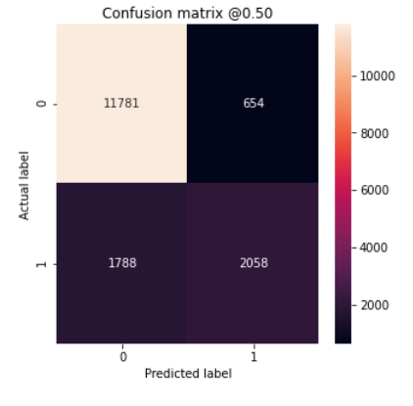
HYPERPARAMETER TUNING
Classification threshold
Range : 0.3 – 0.7
Impact: Various trade off between false positive rate and false negative rate
threshold selected: 0.5
Bias
Zero Bias and Fixed Bias
Result: Lower loss at fixed bias

Slide 9
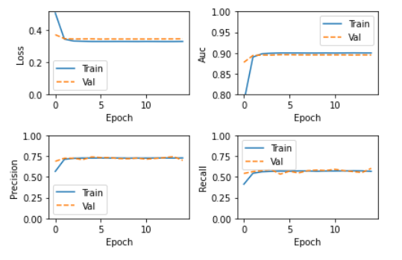
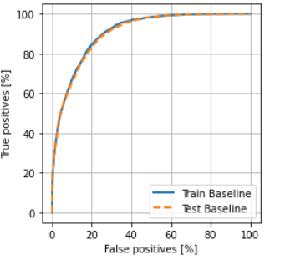
Techniques : Binary Classification
Model selected: Sequential keras model equiped with dropout and early stopping
Cross Validation is performed to check model stability
Due to imbalance target we use several performance metrics: Loss, Accuracy and AUC
AUC of the best model: 0.905

Slide 10
RESULT AND CONCLUSION
We constructed a binary classifier to differentiate people into 2 income classes solely based on their census data
When a probability >= 0.5, it means s/he is more likely to have income higher than $50K
When a probability < 0.5, it means s/he is more likely to have income higher than $50K
The income class can be used as an additional feature for credit scoring analysis to determine people’s credit worthiness
Due to target imbalance, we used AUC as performance metrics
AUC describes how good the model distinguishes two different classes at various probability.
The higher AUC value (>>> 0.5), the higher its capability in separating two classes
Our model AUC is 0.905
Using 11 features from census dataset, our best model can predict people’s income class at accuracy of 0.85

